Slide 1
Brand Pillars and
Market Research
L
evel
With
Me

Slide 2
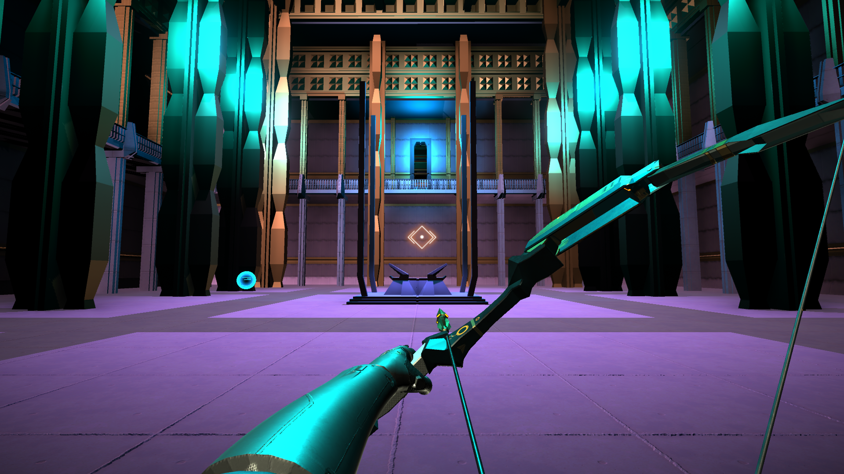
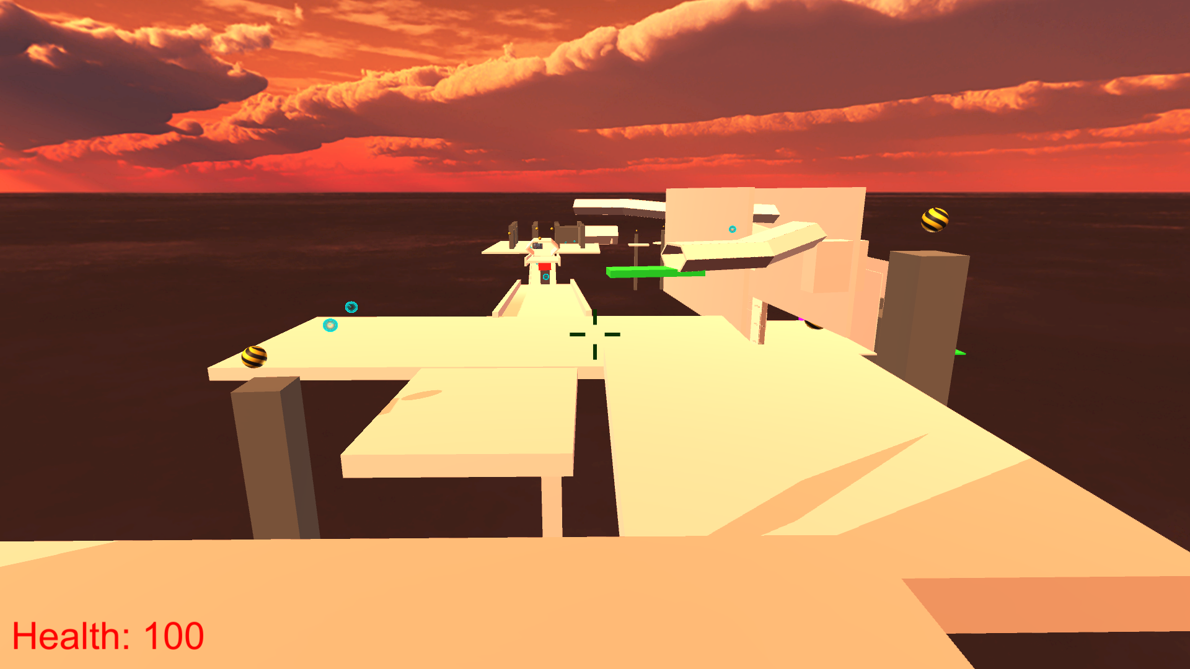
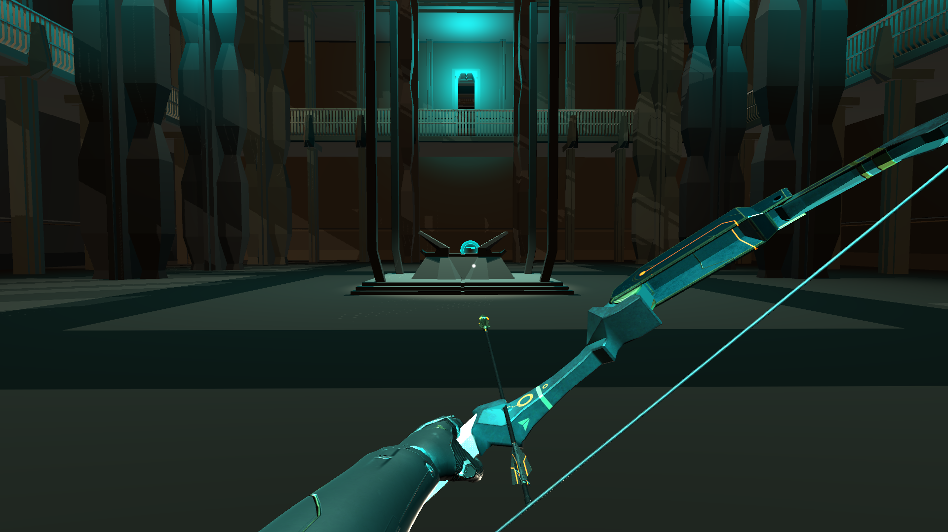
Game Concept

Slide 3
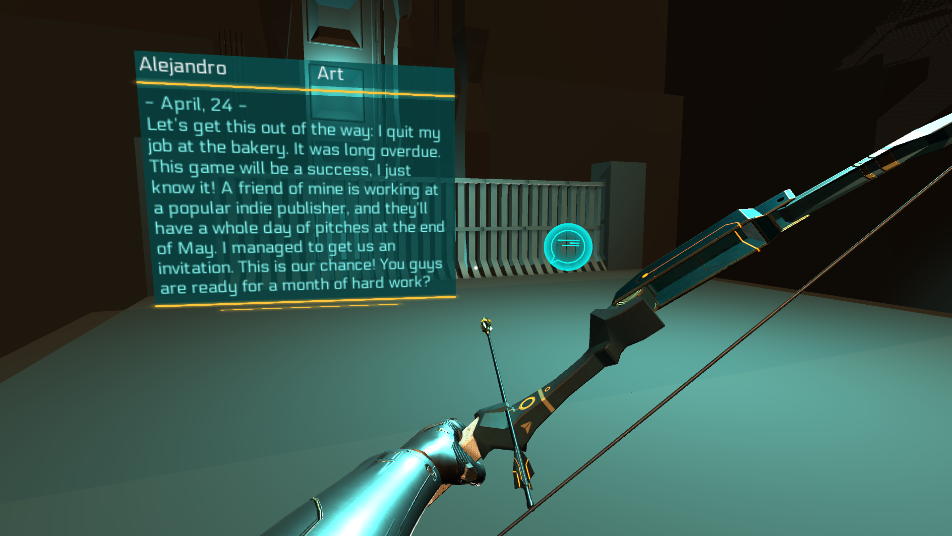

Slide 4




Brand Pillars
Education
Context
Authenticity
Personality

Slide 5
Education
We offer insights on the nature of game development.
Every player should leave our game having learned something new.

Slide 6
Authenticity
We talk from experience.
Everything we teach has happened to us in one way or another.

Slide 7
Personality
We believe in the power of characters.
Our learning experience is embedded in the personal story of a cast of distinct characters.

Slide 8
Context
We teach in a meaningful context.
Our players experience the transformation of various game elements first-hand.

Slide 9

Research Question
How can we reach out
to the niche target group
of this game?

Slide 10
Target Audience

Slide 11

Target Audience
Dedicated players
Core gamers interested in creation

Slide 12

Target Audience
Dedicated players
Core gamers interested in creation
Industry insiders
Journalists, (aspiring) developers

Slide 13

Target Audience
Dedicated players
Core gamers interested in creation
Industry insiders
Journalists, (aspiring) developers
Other creatives
Writers, filmmakers, architects, …

Slide 14


Target Audience
Creativity
“What If?”
Immersion
“Once Upon a Time”
Design
Fantasy
Discovery
Story

Slide 15
Possible Methods

Slide 16
Possible Methods
1
Research behavior in expected places

Slide 17
Possible Methods
1
Research behavior in expected places
2
Find out about unknown places

Slide 18
Possible Methods
1
Research behavior in expected places
2
Find out about unknown places
3
Analyze strategies of similar games

Slide 19
Possible Methods
1
Research behavior in expected places
2
Find out about unknown places
3
Analyze strategies of similar games

Slide 20
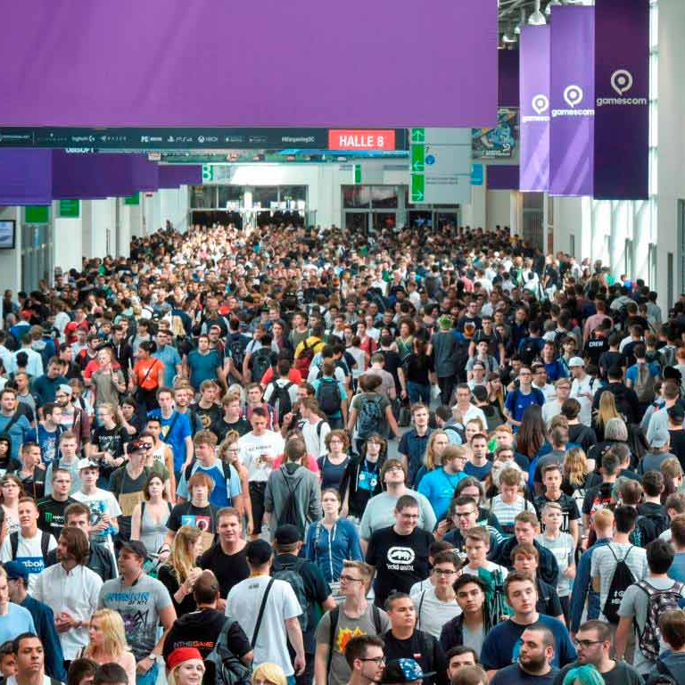
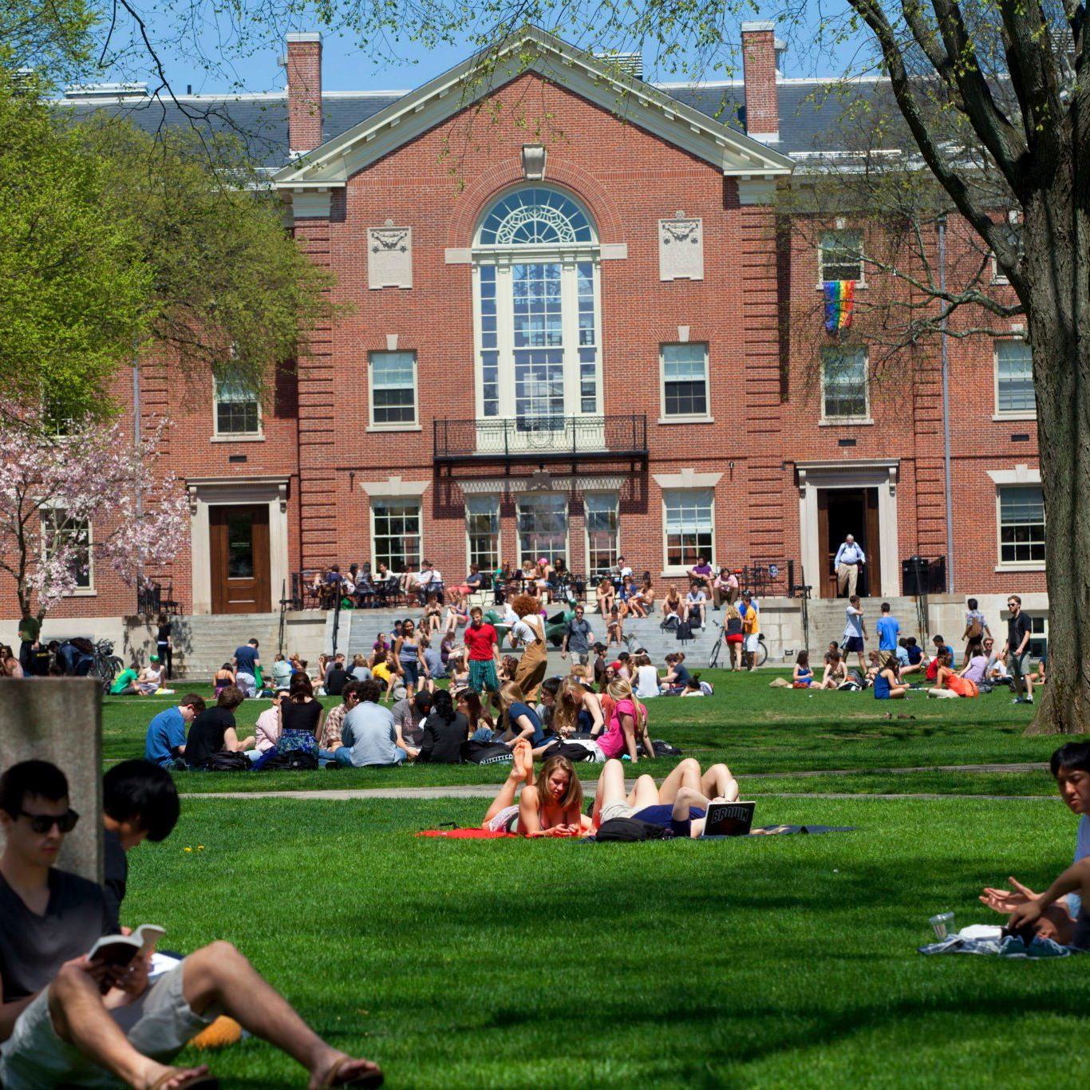
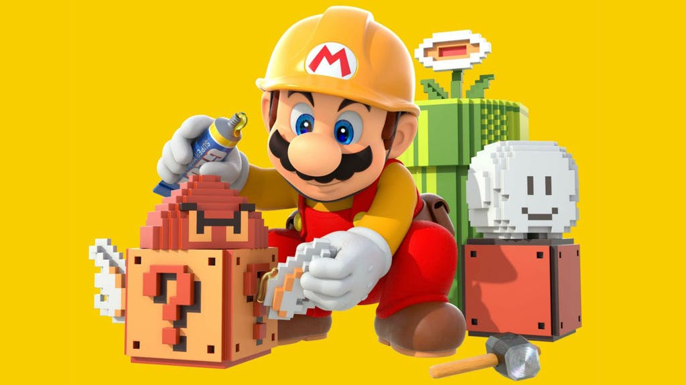
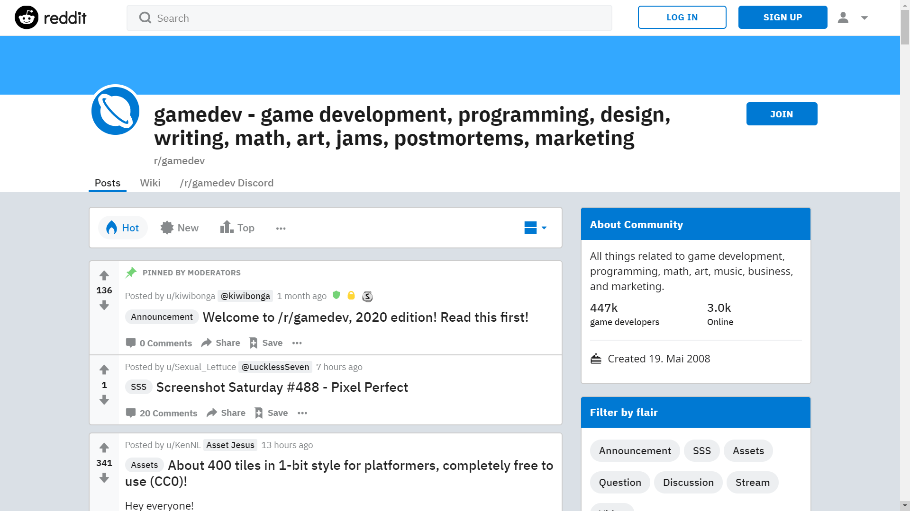
Implementation | Expected Places

Slide 21

Implementation | Unknown Places

Slide 22

Implementation | Unknown Places

Slide 23


Implementation | Unknown Places

Slide 24
Implementation | Unknown Places

Slide 25


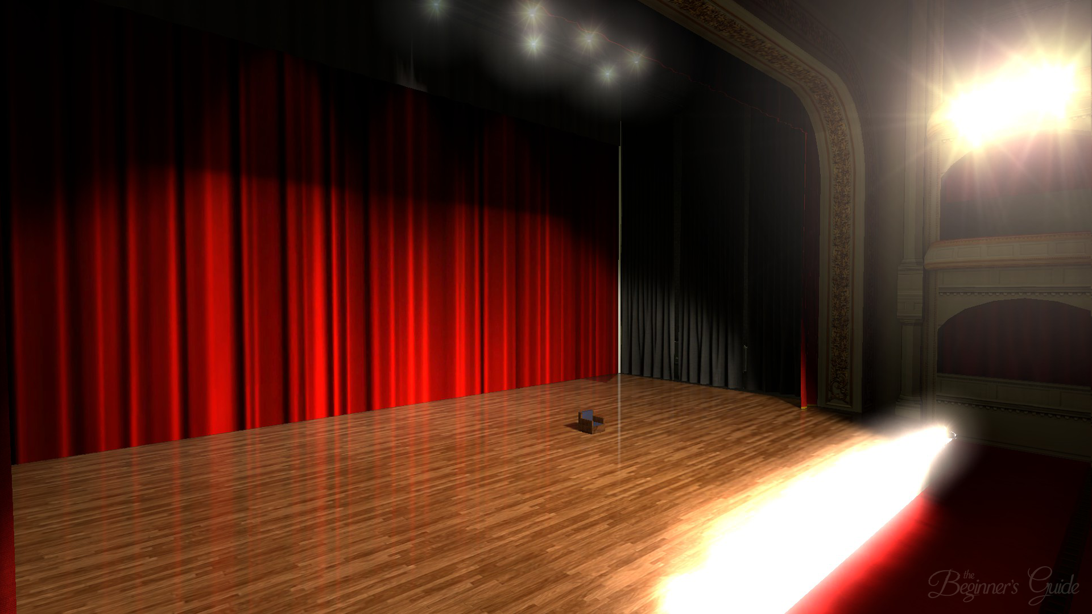
Implementation | Similar Games

Slide 26


Implementation | Similar Games

Slide 27
Implementation | Similar Games

Slide 28
Thank
You!

